Slide 1
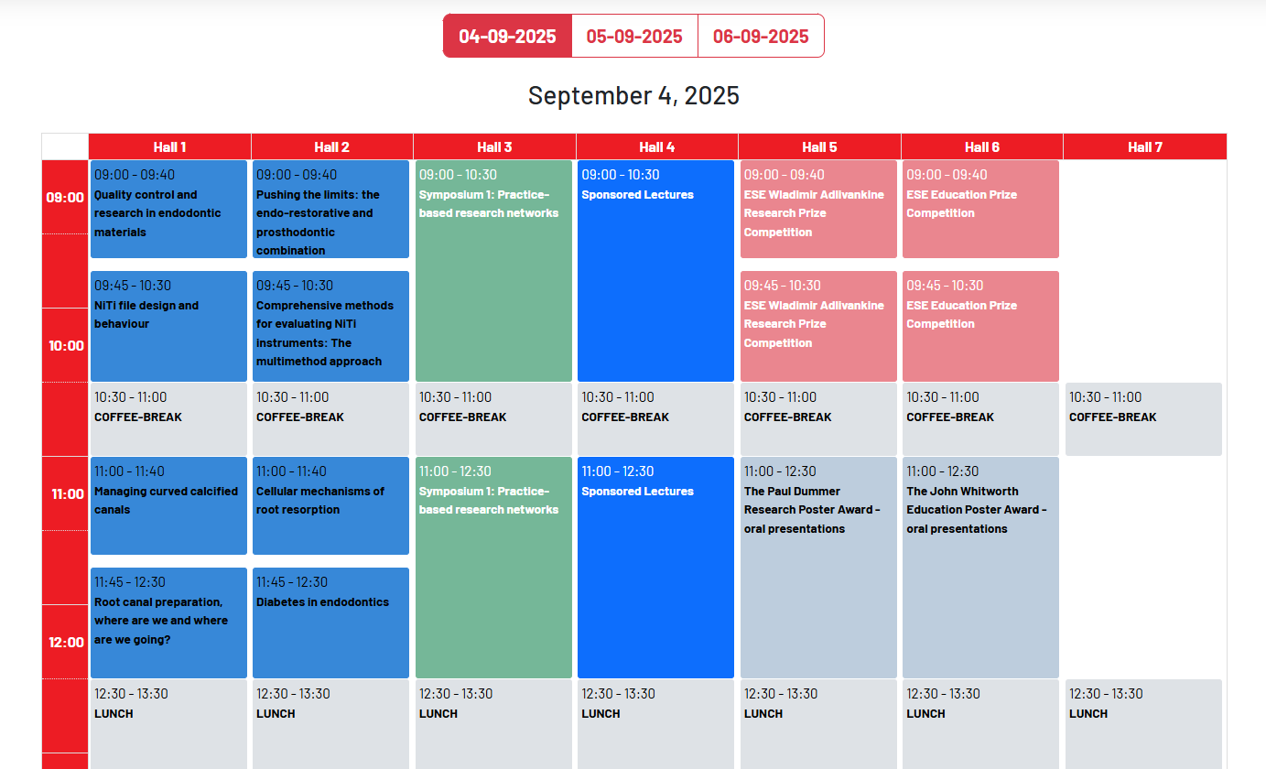
09:00 -09:40
Quality Controll and research ….
08:00-10:30
Symposoium 1……
COFFEE

Slide 2
#45A09D
09:00 -09:40
#B5D5E6
08:00-10:30
#87D7D9
#F1CD9E
#FFFCD6
#EBD1DD
COFFEE
#C0C6D3

